Slide 1

INSTITUTE :UIE
DEPARTMENT: ACADEMIC UNIT 1&4
Bachelor of Engineering (Computer Science & Engineering)
Subject Name and Code:
Physics For Engineers
22SPH-141
Prepared by: Dr. Deepak Kumar, Assistant Prof. Physics
DISCOVER . LEARN . EMPOWER
DIVERGENCE OF LASER BEAM

Slide 2
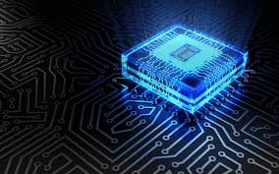
COURSE OBJECTIVES
• The course is designed to make the students industry ready to contribute in the growing demand of the industry at local, national and international level.
• It will make the students competent to understand basic concepts and applications of advanced engineering
physics and apply its principles in their respective fields at global platform.
• It will enhance the skill level of the students and shall make them preferred choice for getting employment in
industry and research labs.
• It will give thorough knowledge of the discipline to enable students to disseminate knowledge in pursuing
excellence in academic areas.
Figure 1 [1]

Slide 3
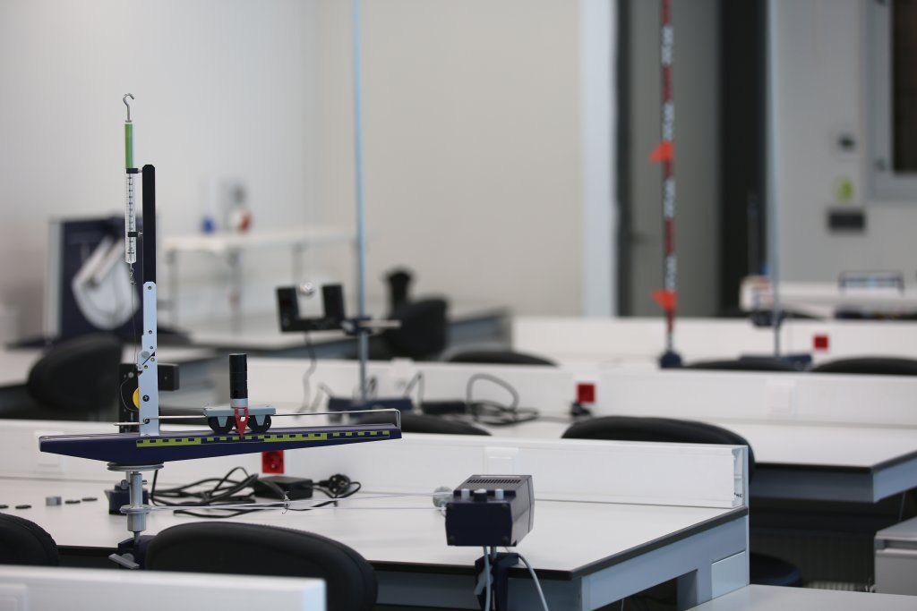
COURSE OUTCOMES
CO Number | Title On completion of this course, the students are expected to learn
CO1 | Quote the basic fundamental concepts of lasers, optical fibres, crystallography, ultrasonic oscillations, semiconductor physics, quantum mechanics and nanotechnology.
CO2 | Demonstrate the working of various lasers, fibre components, semiconductor devices; explain the behaviour of crystalline solids, quantum and nano-scale systems.
CO3 | Solve problems by applying principles related to lasers, fibres, semiconductors, oscillations, quantum and nanoscience.
CO4 | Compare various lasers and fibres, semiconducting devices, crystalline materials, structures at quantum and nanoscale on the basis of their properties for industrial applications.
CO5 | Develop various systems using lasers, fibres, semiconductors and nanomaterials for futuristic applications.
Figure 2 [2]

Slide 4
LIST OF EXPERIMENTS
To find the divergence of LASER beam.
To determine the diffraction using LASER beam and find the grating element of diffraction grating.
To determine the numerical aperture of optical Fiber.
To determine the resistivity of semiconductors by four probe Method.
To draw the static current- voltage characteristics of a Zener diode.
To determine the Hall Voltage and Hall Coefficient Using Hall Effect.
Determine the value of ‘g’ by using Kater’s Pendulum
To find the velocity of ultrasonic wave in the given liquid.
Investigating the Doppler Effect with ultrasonic waves.
Determination of ‘h’ using photocell.
To study photoelectric effect for a metal at different intensities and fixed frequency.

Slide 5
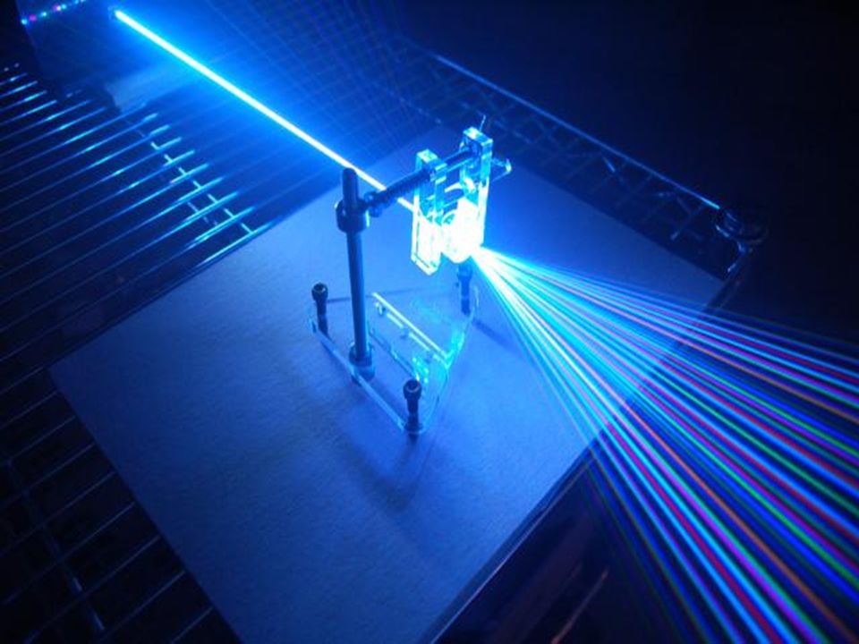
EXPERIMENT TO BE DISCUSSED…
To find the divergence of LASER beam.
Figure 3 Divergence of laser beam [3]

Slide 6
AIM: To find the divergence of LASER beam.
List of Equipment Used:
Table 1: List of Equipments
S.N. | Equipment | Range | Quantity
1. | Power supply/Operating voltage | 5mV/3-12V | 1
2. | Diode laser | 650nm | 1
3. | Stand | NA | 1

Slide 7
Pre-preparation/ Prerequisite
Student is advised to understand the following aspects before carrying out the experiment
Fundamentals of Laser and ordinary light.
Basic principle to achieve various wavelengths by laser light.
Basic principle and working of LASER (Absorption, Emission, Population Inversion and pumping).
Practical applications of laser.

Slide 8
Theory
Divergence:- Divergence describes the expansion of a laser beam over a long distance. The value is given in mrad (milliradian), a unit to specify angles.
The term LASER is the acronym for Light Amplification by Stimulated Emission of Radiation. It is a mechanism for emitting electromagnetic radiation via the process of stimulated emission. There are lasers that emit a broad spectrum of light, or emit different wavelengths of light simultaneously. A laser beam with a narrow beam divergence is greatly used to make laser pointer devices. Generally, the beam divergence of laser beam is measured using beam profiler. Like all electromagnetic beams, lasers are subject to divergence, which is measured in mill radians (milliradian) or degrees. For many applications, a lower-divergence beam is preferable. The divergence of a laser beam is proportional to its wavelength and inversely proportional to the diameter of the beam at its narrowest point.

Slide 9
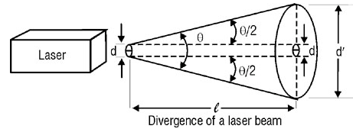
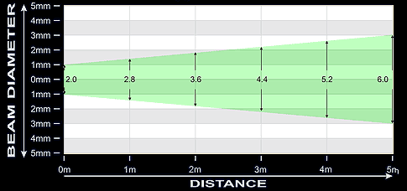
Divergence of LASER beam diagram
Figure 4 (a) Divergence of Laser beam [4]
Figure 5 (b) Divergence of laser beam with increasing distance [5]

Slide 10
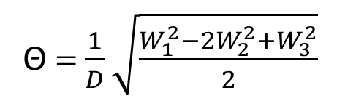
Procedure
Arrange the apparatus as shown.
Pencil, draw the circular spot on the paper and measure the vertical and horizontal diameters of the circular spot. Calculate the mean of both values to get the accurate value of the diameter. This is the waist size W₁
Now distance screen in the direction of beam propagation by a known distance D (total distance from laser becomes Z+D) and measure spot size W₂ as measured in previous step.
Now displace screen further away by same value D, so the new distance becomes (Z+2D). Measure spot size W₃
Put the values in the formula and calculate laser divergence
Formula Used
Θ = $\frac{1}{D}\sqrt{\frac{W_{1}^{2}−{2W}_{2}^{2}+W_{3}^{2}}{2}}$

Slide 11
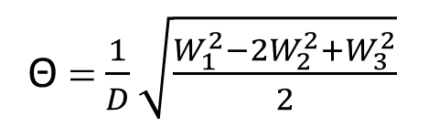
Observations & Calculations:-
Table 2:
Initial distance between laser and screen Z=.........cm
Displacement of screen D=............cm
Θ = $\frac{1}{D}\sqrt{\frac{W_{1}^{2}−{2W}_{2}^{2}+W_{3}^{2}}{2}}$
S. No. | Distance (cm) | Diameter |  | Mean diameter (cm) | (milliradian)
 |  | Vertical (cm) | Horizontal (cm)
1. | Z= |  |  | W ₁
 | Z+D= |  |  | W ₂
 | Z+2D= |  |  | W ₃

Slide 12
Result & Discussion
Result(s): The angle of divergence of the diode laser is ______ milliradian.
Conclusion: Since this angle is very small (in the range of milliradian), we conclude that laser beam is highly directional as compared to ordinary light source.

Slide 13
Sources of error
Screen should be placed normally to the path of the laser beam.
Angle of laser travel and the laser instrument should be perfectly aligned.

Slide 14
Learning Outcomes
On completion students will be able to understand
To understand the importance of laser beam compared to ordinary light
To determine the angle of divergence of the laser beam

Slide 15
Summary
Introduction to Laser light
Working of Laser
Description of Equipments.
Observation table.
Result

Slide 16
Viva voce
What is Divergence of a laser beam?
What is LASER?
What are the characteristics of laser radiation?
What is a Semiconductor Diode Laser?
What is the cause of divergence of a laser beam?
Why population inversion is essential for stimulated emission?

Slide 17
Simulation and video links
Simulation Link:-
lo-au.vlabs.ac.in/laser-optics/Laser_Beam_Divergence_and_Spot_Size/experiment.html
Link for related video: -
Laser fundamentals II: Laser transverse modes | MIT Video Demonstrations in Lasers and Optics – YouTube
Gaussian beam - YouTube

Slide 18
References
https://images.app.goo.gl/onXTfVDfo1WiwTcK9
https://in.pinterest.com/pin/842243567793191631/
https://in.pinterest.com/pin/842243567793191631/
http://physicsopenlab.org/2017/08/29/laser-diffraction-grating/
https://physics.stackexchange.com/questions/147400/accurate-way-to-measure-angular-spread-of-a-laser-beam
https://m.wickedlasers.com/laser-tech/laser_beam_comparison.html

Slide 19
THANK YOU
For Queries:-
deepak.e1972@cumail.in

